Slide 1
NGSE China – Data Readiness Assessment
June 14th, 2023

Slide 2
Objectives of Assessment Report
总体Storyline
Project Background
NGSE是什么 – 一些high level 假大空的话，能为销售代表带来什么样的价值
为什么要做NGSE China – 在US和其他国家已经收获了较大成效，但由于中国数据安全法的原因，如果想要落地则需要进行本土化实施
NGSE是通过什么方式来实现预测的 – 实际最终就是基于销售、产品、客户、活动等数据，计算多个标签 eg：New Product Purchased Flag（客户在过去24个月从来没买过的品牌，突然在8周内购买了）、Up sell Flag（基于客户历史销售数据，试图卖给客户额外或更贵的品牌）…….
所以显然要计算出这些flag，我们就得有销售、产品、客户、活动等数据
为什么中国有单独的data assessment过程 – 销售模式和使用的业务系统不同，导致同一个数据主题域下的数据结构和内容差异大，需要评估现有数据是否满足NGSE要求&是否需要引入新的数据
Data Module list
(总图，配合Vince划分的core/basic/advance，有一个系统来源对比。还有基于最终对比情况在这几个module下打星，5*数据非常ready，没有重要字段遗漏；4*部分关键数据缺失，接入新系统可以解决；3*部分关键数据缺失，业务定期额外维护（手工/系统）可以解决；2*大量关键数据缺失，可能影响预测准确性；1*完全缺失，建议不实施该模块预测)
Sales (***)
Master Data（XXX）
Campaign
Market Research
Call
Detailed Comparison on Common Data Module
(分图，每个module可能需要多页片子：现状+痛点+解决方案。
China Enhancement
(基于中国业务模式和数据情况建议NGSE引擎给中国定制化开发的部分)
新增Flag和使用场景 - 除了6个现有Flag之外建议增加的flag，中国建议和可以提供的features有哪些，中国会合并好feed给NGSE的表有哪些，预计可以使用的AI model是哪种
已有Flag的feature增强 – 中国建议在现有Flag中增加的Feature，建议增加的理由是啥，这部分feature的数据来源是啥

Slide 3
What is Next Generation Sales Engine?
1
Learn about NGSE International
Next Generation Sales Engine (NGSE) is an enhanced capability to improve customer experience and drive growth
…through advanced predictive analytics to optimize how we understand and meet customer needs
…with a digitally-enabled field force and inside sales team closely collaborating, also with marketing
With NGSE International, capabilities first built in the US are transferred and adapted based on local market needs to better support the sales and marketing team in reaching their targets
Notes:
1) It’s not adding more to the reps…it’s streamlining what they have and introducing new insights
2) Aggregation of data from touchpoint, sales reports, marketing interactions, etc
3) Artificial Intelligence & predictive modeling to help automate analytics & get to insights quicker
4) next best action summary based on behavior trends. Cross-sell and up-sell potential
5) improved one-Zoetis customer 360 views across the commercial channels, technical and customer support

Slide 4
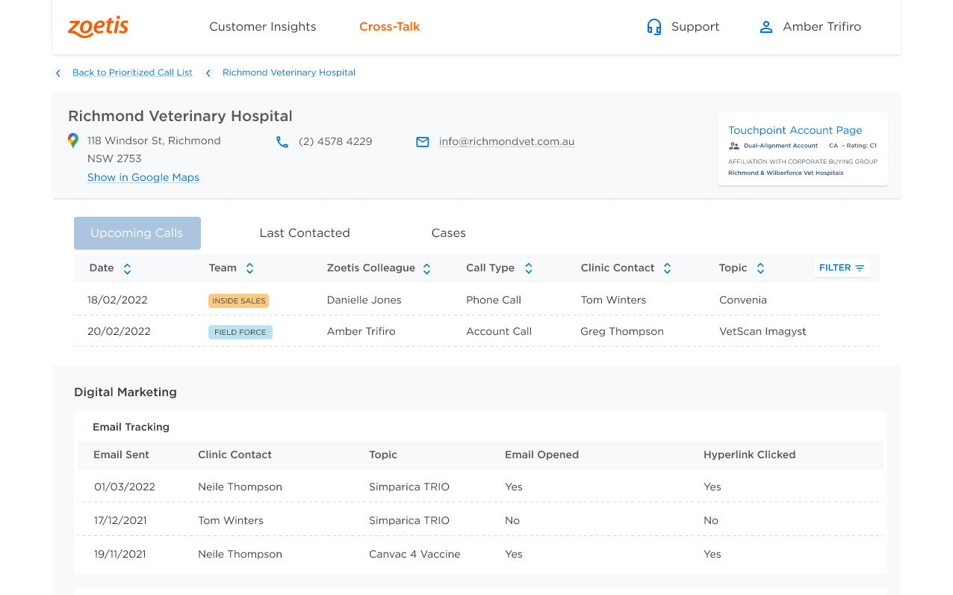
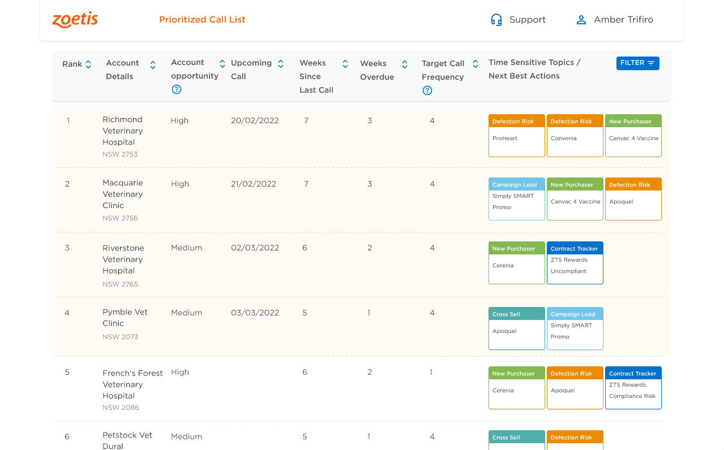
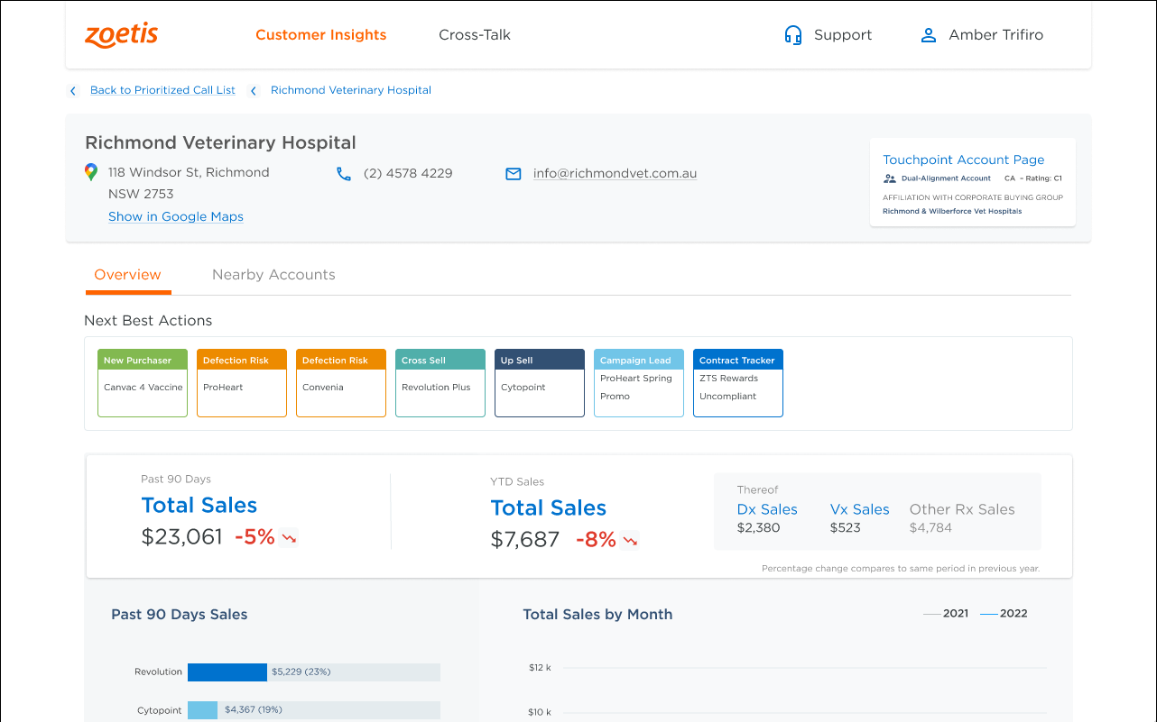
Frontend Tabs in NGSE that support your daily workflow
NGSE Tabs Localization
China Enhancement
Prioritized Call List
Customer Insights
Cross-Talk
Wechat Page
Territory planning
Call Planning and Pre-call Planning
Pre-call Planning and Post-call follow-ups
Wechat demo
future work
Ranked/Prioritized list of all of a rep's accounts to contact based on time since last contact and key time-sensitive discussion topics ("Next-best-actions" or "NBAs")
Single dashboard for all essential account information incl. sales overview per brand, contract information, discounts and campaign leads – helping you to identify and confirm customer needs and develop tailored solutions
Single source of truth for all past and upcoming interactions an account has with Zoetis across salesforce (Rx, ISR, DAM), Customer Service and Product Support
Except for existing tabs, sales representative can also access NGSE Portal via Wechat
Integrate with Wechat mini program to show results on wechat
Existing Global NGSE Tabs, can be localized in China with minimal adjustment as long as data ready

Slide 5
Pain Points during NGSE Localization in China
Sales Mode
Campaign Mode
Business System
Data Quality
痛点/需要长时间assessment的原因
销售模式不同（DTC vs Indirect Sales）
业务开展模式不同（eg 市场活动玩法不一样）
使用的业务系统不同（SAP vs ufida&QTData）
工作模式不同（导致Touchpoint使用率不高）
数据质量未知（udesk数据需清洗后使用）
需要评估现有数据是否满足NGSE要求&是否需要引入新的数据

Slide 6
China Data Readiness Assessment Method – Overall Roadmap
Confirm Data Scope
Data Classification
System Comparison
50 % From Global DDP
Sales
Master Data
Market Research
Sales – SAP vs Ufida + QTData
Call – Touchpoint
CRM – Wechat vs Touchpoint
Campaign – Wechat Mini Program vs Touchpoint
…….
50 % From Touchpoint
Call
Campaign
……
Confirm with Global NGSE Team about Data Source System and Data Tables
Target - Rebuild all tables on China DDP
Classify Tables into Different Data Modules
Confirm Assessment Priority of Data Modules
Data Quality Check
Data Cleansing and Merge
Attribute Comparison
Check Data Quality from Different Dimensions to Make Sure China DDP Provide Correct Data to NGSE
Integrate Necessary Data Source to China DDP
Data Transformation to Meet Required Format
Merge Data to Meet Required Structure
Generate Sample Data to Final Result Tables
For NGSE needed Data Tables, Find Corresponding Tables on China DDP
Compare Attribute Difference between Current China Tables and NGSE needed Tables

Slide 7
China Data Readiness Assessment Method – NGSE Intl Data Flow
16Tables
RDM
Global DDP DW Tables
Not Stable
May change frequently
DNA – Data
(ADLS Gen2)
NGSE AI engine
ERP
26 Tables
Global DDP ODS Tables
19Tables
Touchpoint

Slide 8
China Data Readiness Assessment Method – Confirm Data Scope
Global DDP
Touchpoint
Table Name | Data Module | Table Description
dim_Customer | Master Data | Customer Master Data
dim_source_Customer | Master Data | concat distributor code and end customer code
dim_Source_Product | Master Data | concat distributor code and product code
dim_Product | Master Data | Product Master Data
dim_Territory | Master Data | Position Master Data
dim_Sales_Representative | Master Data | Sales_Representative Master Data
dim_Market_Code | No need | No need in China
rpt_Currency_Conversion_Rate | No need | No need in China
rpt_GSA_Sales_Allocation_INTL | Sales | Similar to RPT sales Table
rpt_GSA_Sales_Allocation_Germany | No need | No need in China
fact_Account_Position | Master Data | Account Position Relationship
dim_TP_Account_Position | Master Data | Dim Account Position
fact_Customer_Brand_Potential | Sales | Brand Potential (From TP)
dim_TP_Customer_Brand_Potential | Sales | Dim Brand Potential (From TP)
fact_CallDetails | Call | Call (From TP)
rpt_Species_Alloc_Aligned_Sls | Sales | Union of Direct and Indirect Sales
Table Name | Data Module
account | Master Data
eu_account_affiliation | Master Data
eu_species | Master Data
contact | Master Data
eu_territory | Master Data
user | Master Data
eu_position | Master Data
eu_account_position | Master Data
call | Call
attendee | Call
us_event_account | Event
events | Event
campaign | Campaign
campaign_member | Campaign
eu_campaign_account | Campaign
eu_potential_brands | Unknown
eu_account_species_potential | Unknown
asset | Unknown
case | Other
Rebuild 13 tables on China DDP
Integrate From Global DDP
or use data from MDE

Slide 9
China Data Readiness Assessment Method – Data Classification
Sales
Master Data
Call Activities
rpt_Species_Alloc_Aligned_Sls
dim_Customer
dim_source_Customer
fact_CallDetails
fact_Customer_Brand_Potential
dim_Product
dim_TP_Customer_Brand_Potential
dim_Source_Product
rpt_GSA_Sales_Allocation_INTL
dim_Territory
dim_Sales_Representative
Market Campaign

Slide 10






China Data Readiness Assessment Method – System Comparison
Direct Market
Indirect Market
CRM
Call Center
Market Campaign
Market Research
China Source System
Ufida
(Zoetis to Distributor)
QTData
(Distributor to customer)
No Source System
Collected by website survey
WeChat
Touchpoint
UDESK
Mini Program
Has integrated to China DDP
/
/
Global Source System
Five9
SAP
RDM
Touchpoint
Touchpoint
Monkey Service
Features
ERP
Order
Finance
Shipment
Inventory
ERP
Zoetis > Distributor
(Order Level)
Distributor > Customer
(Aggregated to Daily Level)
Campaign Call Activity (SFE)
Regular Call
Call Center
Campaign related data
Global (customer feedback on products)
China (customer feedback on distributor)

Slide 11
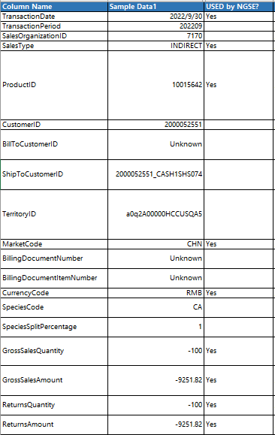
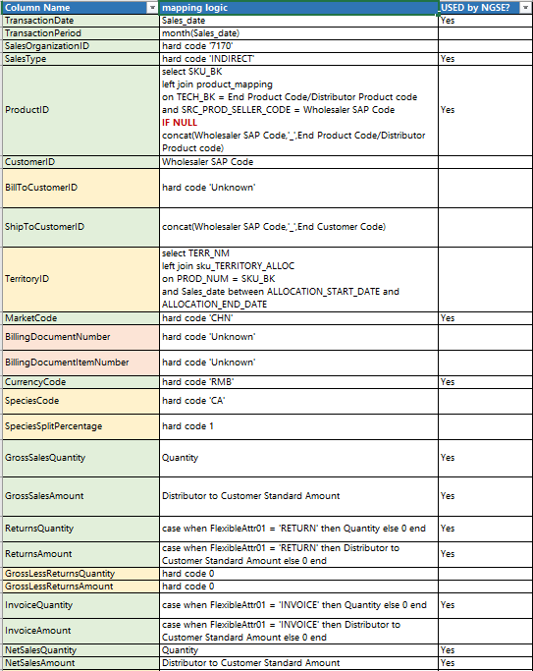
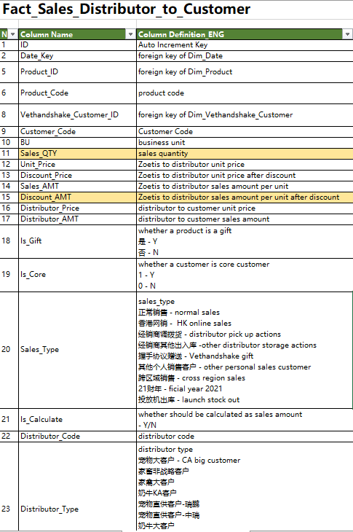
China Data Readiness Assessment Method – Attribute Comparison
Global DDP Table Structure
Final Mapping Logic
China DDP Table Structure
Table Structure on Global DDP.
Our Target is to rebuild exactly same structure tables on China DDP and generate data.
Figure out transformation logic from China DDP structure to Global DDP structure
Decide next actions based on comparison result – Integrate new data/ remain missing
Current table structure on China DDP of same data module
Difference caused by source system and sales mode

Slide 12
China Data Readiness Assessment Method – Data Cleansing and Merge

Slide 13
China Data Readiness Assessment Method – Data Quality Check

Slide 14
to be optimized
China Indirect Sales - Sales Mode and Source System
Sales Mode
Distributor Sell-In
Distributor Sell-Out
Corresponding system
Ufida
QTData
Corresponding system
Ufida
QTData

Slide 15
China Indirect Sales - Current Stage
Data Source
Data Module
Challenging Part
Sales Data
(currently working on)
1. Sales Mode Difference – Direct sales vs Indirect Sales
Global DDP
50%
2. Source System Difference – SAP vs Ufida+QTData
Master Data
Data Structure
Data Quality
Call Center Data
Current Stage
……
Done
Finish 1st round of sales data structure comparison
Figure out whether current sales data structure on China DDP can cover NGSE sales data requirements
Estimate influence of attributes that China DDP lack
Flexible attributes and will not be used in actual NGSE data processing - FINE
Mandatory attributes that influence final forecast results – not found, China DDP can provide all the indirect sales information that NGSE needs
Next Step
2nd round check with Global DDP team and Business Team
Campaign Data
Touchpoint
50%
Regular Call Data
Other CRM

Slide 16
China Indirect Sales - Assessment Result
Data Structure Side
Data Quality Side
Total Required Attributes : 60
By Product : QTY and AMT 100% Match
Flexible Attributes : 48
Must Have Attributes : 12
By Customer : QTY and AMT 100% Match
Missing Attributes: 31
Direct Sales Related Attributes – No Need in CHN Market
Available Attributes: 17
China DDP will Still Provide Data for Future Use
Available Attributes: 12
By Date : QTY and AMT 100% Match
Hardcode ‘Unknown’
Mapping Logic
Data Readiness Assessment Result : 5* Readiness
No need to integrate other data source
China DDP indirect sales table can provide all information NGSE need
Final Result

Slide 17
China Indirect Sales - Data Flow
Current Data Flow
Future Data Flow
Source System
QT Data
QT Data
Source System
Current MDE module, for some business side manual cleansing
SFE Portal
SFE Portal
Current MDE module, for some business side manual cleansing
Manual Export
EXCEL
China DDP
China DDP
Manual Upload
SFTP
ODS
ODS
Current ODS Layer
RDM
Current Fact Table, built based on dimensional modelling, contains dimension surrogate key
DW Fact
DW Dim
DW Fact
Global DDP
Data Staging and Error Detect
STG
DWS Fact
Similar to Datamart
Do pre-calculating
New table in existing schema
Same Structure as current RDM Table, for other global data requirements
DWS Fact
Global Data Warehouse Modeling
DW Fact
rpt_Species_Alloc_Aligned_Sls
Power BI Dashboards
New table in new schema
Same Structure as current Global RPT sales table
for NGSE use only
NGSE Data Table
rpt_Species_Alloc_Aligned_Sls
DNA and Following Data Processing

Slide 18
China Indirect Sales - Next Action
Next Action
接入新系统
接入旧系统新表
在原有DDP中新增表
在原有DDP原有表中新增字段
新增计算逻辑
手工维护
………
Owner
China ZTD
Global ZTD
China Business Team
………
TO BE DISCUESSED
Timeline
Task之间的dependency
每件事情的完成时间
时间轴
每个module有单独的详细计划
整份report最后会有总体的2024计划

Slide 19
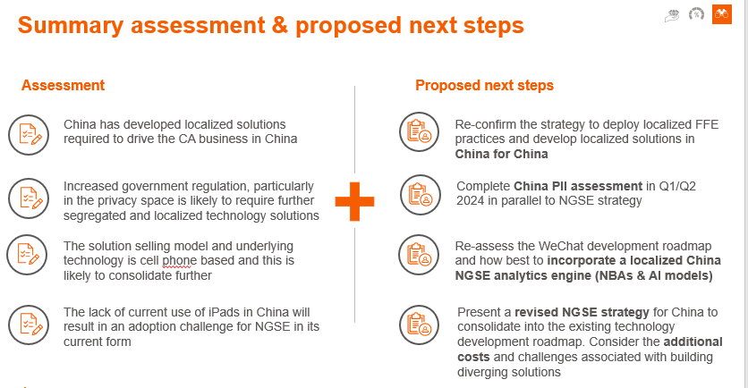
第一页先写结论+后续步骤

Slide 20
第一页画数据流，画单独customer master这一个，之前有一页数据流ppt的，放进来就好

Slide 21
评估结果，从字段和数据记录两方面
字段：总共XX字段，NGSEmusthave XX个字段，分别我们提供了哪些字段
数据记录：条目数（TP+RDM+MDE三部分balab）

Slide 22
rpt_Species_Alloc_Aligned_Sls - Summarize

Slide 23
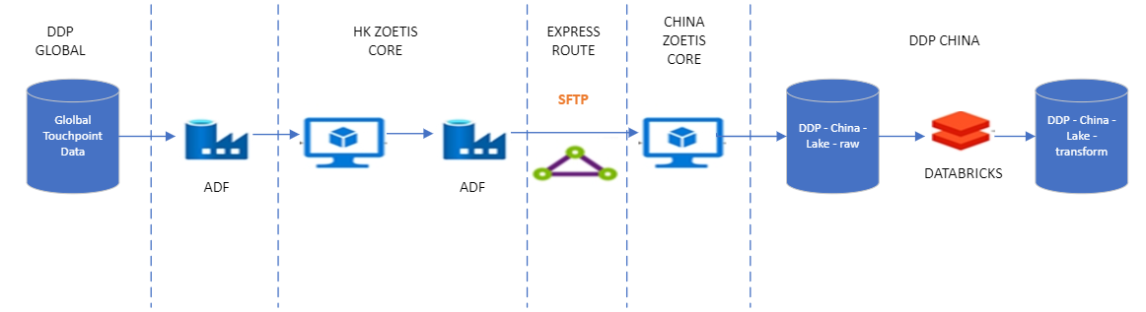

Slide 24
rpt_Species_Alloc_Aligned_Sls - Data Flow
Sales Data
MDE sales monthly flow data
DDP distributor
MDE account SAP code
DDP customer
MDE product sku
DDP product
MDE product sku SAP code
Territory Info
DDP position_account Info
rpt_Species_Alloc_Aligned_Sls
DDP position Info
touchpoint position Info

Slide 25
rpt_Species_Alloc_Aligned_Sls - Assessment ResultD
Data Structure:
Total Required Attributes : 60
Must Have Attribute: 13
Flexible Attributes: 47
Missing Attributes: 29 (Hardcode)
Available Attributes: 18
Data Quality:
By Product: QTY and AMT 100% Match
By Customer : QTY and AMT 100% Match
By Date : QTY and AMT 100% Match
For 2017 records of customer code not found.
For 356554 record of e_product_sku_sap_mde.uf_sku_id not found
For 1360687 records of e_account_sap_mde.account_id not found
For 120963 records of TerritoryID is null
The qualified record count for 56%
Mapping Logic: 34 Attributes
Score:

Slide 26
Dim_customer - Data Flow
rpt_species_alloc_aligned_sls
RDM Customer
Touchpoint Customer
dim_customer
MDE Customer

Slide 27
Dim_customer - Assessment ResultD
Data Structure:
Total Required Attributes: 121
Must have Attributes:9
MDE customer:
China provides attributes: 27
Missing attributes (hardcode): 94
RDM customer Info:
China provides attributes: 23
Missing attributes(hardcode):98
Touchpoint customer:
China provide attributes: 52
Missing attributes(hardcode): 69
Data Quality:
From MDE: Count 100% Match
From Touchpoint: Count 100% Match
For 572 records not align from MDE to touchpoint
For 39739 records customer data from RDM
Score: 100%

Slide 28
Dim_product - Data Flow
DDP product
MDE product
dim_product
MDE product sku sap code
Touchpoint product

Slide 29
Dim_product - Assessment ResultD
Data Structure:
Total Required Attributes: 83
Must have Attributes:5
Flexible Attributes: 28
China provides attributes: 11
Missing attributes (hardcode): 67
Data Quality:
From MDE: Count 75% Match
For 92 records not match because lack of sap info.
Score: 100%

Slide 30
Dim_source_product - Assessment Result
rpt_species_alloc_aligned_sls
RDM source product
MDE source product
Dim_source_product
Touchpoint source product

Slide 31
Dim_source_product - Assessment ResultD
Data Structure:
Total Required Attributes: 24
Must have Attributes:9
MDE customer:
China provides attributes: 24
Missing attributes (hardcode): 10
RDM customer Info:
China provides attributes: 18
Missing attributes(hardcode):16
Touchpoint customer:
China provide attributes: 33
Missing attributes(hardcode): 1
Data Quality:
From MDE: Count 75% Match
From Touchpoint: Count 100% Match
For 4701 records from RDM
25% not matched records because lock of sap info
Score: 100%

Slide 32
Dim_source_customer - Assessment Result
rpt_species_alloc_aligned_sls
RDM source customer
Dim_source_customer
Touchpoint source customer

Slide 33
Dim_source_customer - Assessment ResultD
Data Structure:
Total Required Attributes: 29
Must have Attributes:3
RDM source customer:
China provides attributes: 19
Missing attributes (hardcode): 10
Data Quality:
From RDM: 21893 Count
Score: 100%

Slide 34
Dim_territory - Assessment Result
DDP position
Dim_territory_customer
Touchpoint position

Slide 35
Dim_territory - Assessment ResultD
Data Structure:
Total Required Attributes: 64
RDM source customer:
China provides attributes: 50
Missing attributes (hardcode): 14
Data Quality:
From DDP: Count 100% Match
From Touchpoint: Count 98% Match, because touchpoint data refresh gap
Matched 270 records, Not matched 5 records.
Score: 100%

Slide 36
Dim_sales_representative - Assessment Result
Workday:china_employee_info
Dim_territory_customer
Touchpoint: user
Touchpoint: eu_position

Slide 37
Dim_ sales_representative - Assessment ResultD
Data Structure:
Total Required Attributes: 28
RDM source customer:
China provides attributes: 19
Missing attributes (hardcode): 9
Data Quality:
From wokday: Count 98% Match, because touchpoint data refresh gap
Score: 100%

Slide 38
Dim_tp_account_position - Assessment Result
Touchpoint account position data
Dim_tp_account_position

Slide 39
Dim_ tp_account_position - Assessment ResultD
Data Structure:
Total Required Attributes: 12
RDM source customer:
China provides attributes: 12
Missing attributes (hardcode): 0
Data Quality:
From touchpoint: Count 100% Match
Score:

Slide 40
fact_account_position - Assessment Result
DDP position account
DDP customer
Fact_account_position
Touchpoint account position
NGSE territory
Workday china employee info
NGSE dim_sales_representative
NGSE dim_tp_account_position

Slide 41
fact_account_position - Assessment ResultD
Data Structure:
Total Required Attributes: 8
RDM source customer:
China provides attributes: 8
Missing attributes (hardcode): 0
Data Quality:
The count is 78491 records.
18473 dimSalesRepresentativeKey are not matched
11 dimTPfactAccountPositionKey are not matched
Score:

Slide 42
dim_Sales_Organization and dim_Market_Code - Assessment ResultD
Dim_Sales_Organization and dim_Market_Code are configuration data. They are hard code.

Slide 43
China Enhancement
建议增加的一些flag
需要的数据源
支撑
预计能为中国销售代表提升业绩带来的价值
Source: NGSE International

Slide 44
China Enhancement
建议在现有flag中增加的Feature
需要的数据源
支撑
预计能为中国销售代表提升业绩带来的价值
Source: NGSE International

Slide 45
Roadmap for 2024
最后，在数据评估后，根据中国的数据情况，建议的NGSE China 2024 落地的Roadmap

